Slide 1

Product Identification Assistant
Idea Pitch & Presentation
Team – ThinkStrange

Slide 2
Statement
The application allows users to capture a photo of any electronic product (could also include cars and electric appliances)
The app will return with the identified product’s brand, make and model, along with a comprehensive collection of tables filled with the application’s features sorted based on different categories
It would also include a component that compares that product’s previous prices across different websites and plots the data on a graph
It would also include a reviews component that shows the top most reviews for that product.
Considering price, reviews and popularity of that platform of purchase, it concludes the best website to buy it from.

Slide 3
Features
Easily figure out which product and what it is made of just by pointing your phone at it
Dissimilar to google lens because lens just returns a bunch of search results while our application’s goal is to give the information right away. raw facts.
Eliminates the need of a salesperson at any store. One can youse their own phone to scan a product and get a comprehensive outlook on it
Shows you raw data, review and links to where to buy it from. Apart from that, also considers multiple factors and compiles a graph that predicts already-bought user’s best choices.

Slide 4
Logic
To make sure every device gets identified, a small and discreet code can be beamed out of every device such that the application can pick that signal, verify that code with an existing DB, and return the properties of that signature which are the results the user gets to see.
Once post verification and pre service, the model will update the properties of that product to the latest standard and then delivers the entire set.

Slide 5
Limitations
Most products don’t have a signal that emits a code unique to the app
Implementing the code signal would mean to write different programs for every category or type of product in the market
Another way of approaching this, in-order to eliminate the above two points, would mean to directly compare the taken image to an already existing dataset. But here probability plays a huge role, and getting the right details for the right product Is crucial.

Slide 6
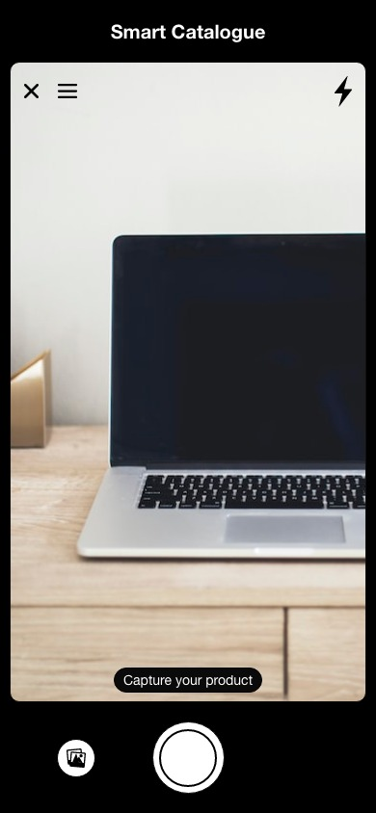
Home
We can capture the image using our camera

Slide 7
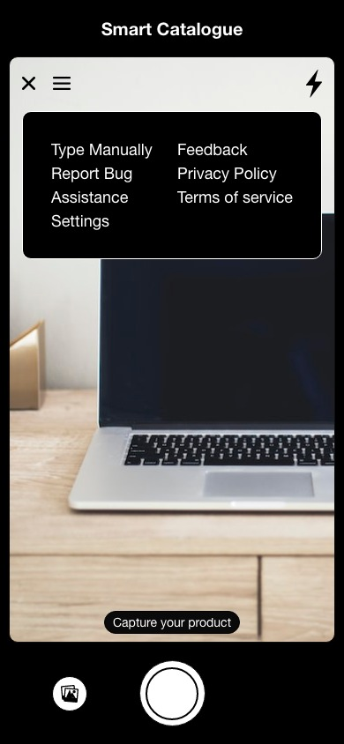
Home Menu
Menu popup at the home page

Slide 8
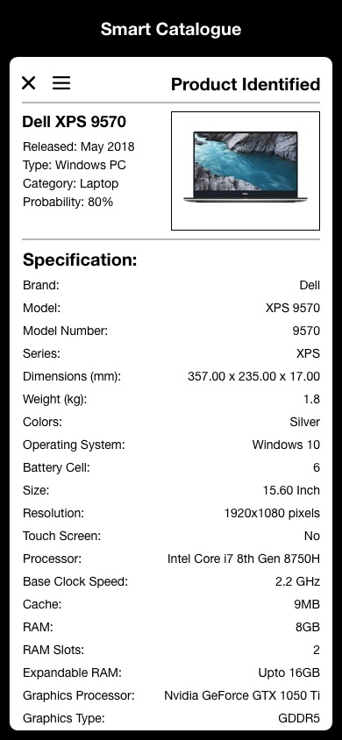
Product Information
Once the camera takes the pic, the application processes the image and returns the details

Slide 9
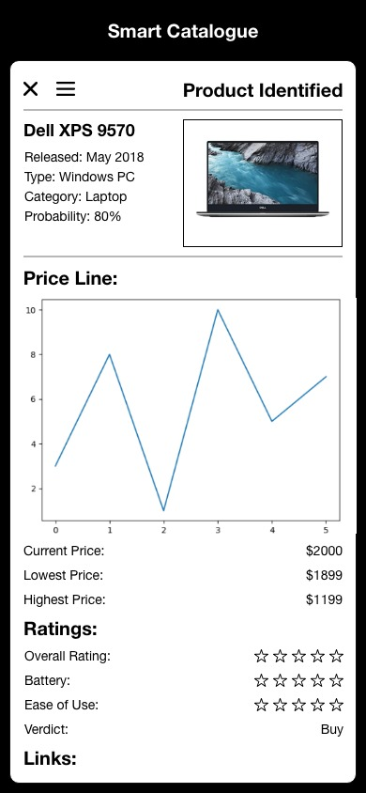
Product Information - contd.
The app has features to compete the price graph considering all the factors such as events, offers, coparisions between multiple ecomm websites and compiles it neatly.

Slide 10
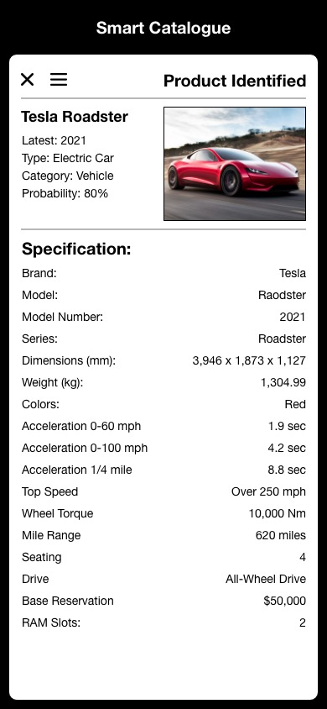
Product Information - contd.
The app is not limited to devices. It can capture and identify cars or even appliances

Slide 11
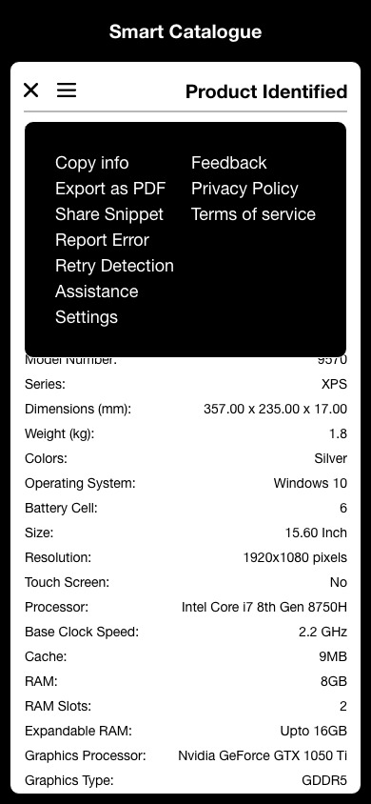
Product Information Menu
All the options the user is offered with once a product has been identified

Slide 12
Thank You
Nice experience

